Slide 1
BOOLEAN LOGIC
Michael D’Argenio – mjdargen@ncsu.edu
Electrical Engineering – SS 2019 – Duke TIP

Slide 2
LEVELS OF ABSTRACTION

Slide 3
LEVELS OF ABSTRACTION
Software
Programmable Logic
Hardware
Fundamental Theorem of Software Engineering:
"We can solve any problem by introducing an extra level of indirection.“ – Andrew Koenig

Slide 4
INTRO TO LOGIC GATES

Slide 5


Hardware Level: Transistors
Transistors are electrical switches that either allow current to flow or not. i.e. they have two states.
Binary - a data representation that uses two symbols: 0 and 1
Boolean - a data type that consists of only two possible values:
0 = FALSE = OFF =
1 = TRUE = ON =
Why two states?

Slide 6
Programmable Logic Level: Gates
Gates are composed of multiple transistors.
Called “gates” because they switch current on or off.
Based on the inputs, Boolean operations either produce a TRUE (1) or FALSE (0) result.
Basic Boolean logic operations
AND
OR
NOT

Slide 7
Truth Tables
A way of representing the result of a Boolean operation.
Inputs are shown on the left hand side.
Output is shown on the right hand side.
Input A | Input B | Output
0 | 0 | 1
0 | 1 | 0
1 | 0 | 0
1 | 1 | 0

Slide 8
Truth Tables: 2 Truths and a Lie
Truths = 1; Lie = 0
Complete the truth table to have an output of 1 if the inputs are correct (i.e. 2 truths and 1 lie).
Input A | Input B | Input C | Output
0 | 0 | 0
0 | 0 | 1
0 | 1 | 0
0 | 1 | 1
1 | 0 | 0
1 | 0 | 1
1 | 1 | 0
1 | 1 | 1

Slide 9
Truth Tables: 2 Truths and a Lie
Truths = 1; Lie = 0
Complete truth table to have an output of 1 if the inputs are correct.
Input A | Input B | Input C | Output
0 | 0 | 0 | 0
0 | 0 | 1 | 0
0 | 1 | 0 | 0
0 | 1 | 1 | 1
1 | 0 | 0 | 0
1 | 0 | 1 | 1
1 | 1 | 0 | 1
1 | 1 | 1 | 0

Slide 10
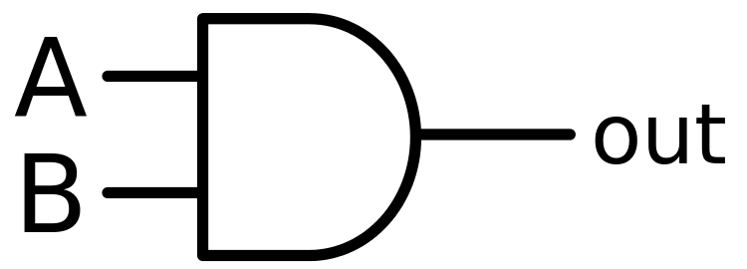
AND

Slide 11
What is an AND gate?

Slide 12

AND
Exp: We need a hammer AND nails to hang a picture frame.
We can’t just have one.
For the AND operation to be true, we need both to be true.
Known as a logical conjunction.
Input A | Input B | Output
0 | 0
0 | 1
1 | 0
1 | 1

Slide 13
AND
Exp: We need a hammer AND nails to hang a picture frame.
We can’t just have one.
For the AND operation to be true, we need both to be true.
Known as a logical conjunction.
Input A | Input B | Output
0 | 0 | 0
0 | 1 | 0
1 | 0 | 0
1 | 1 | 1

Slide 14

OR

Slide 15
What is an OR gate?

Slide 16
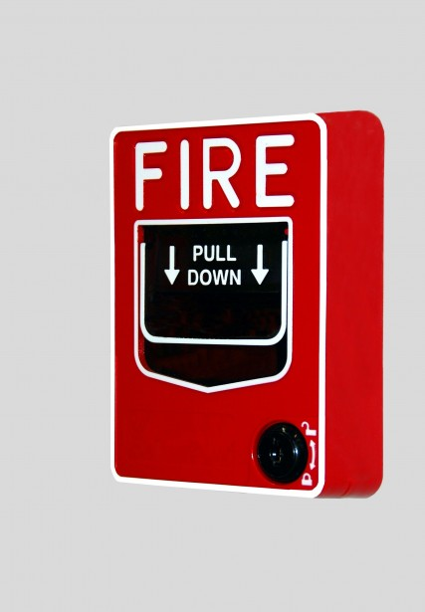
OR
Exp: “If you need anything, don’t hesitate to call or drop by.”
You can do one, the other, or both.
Considered Inclusive OR.
For the OR operation to be true, we only need 1 to be true but both can be true.
Known as a logical disjunction.
Input A | Input B | Output
0 | 0
0 | 1
1 | 0
1 | 1

Slide 17
OR
Exp: “If you need anything, don’t hesitate to call or drop by.”
You can do one, the other, or both.
Considered Inclusive OR.
For the OR operation to be true, we only need 1 to be true but both can be true.
Known as a logical disjunction.
Input A | Input B | Output
0 | 0 | 0
0 | 1 | 1
1 | 0 | 1
1 | 1 | 1

Slide 18
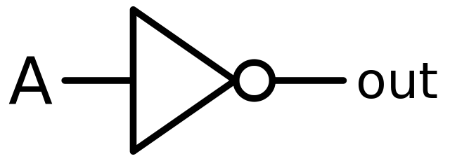
NOT

Slide 19
What is a NOT gate?

Slide 20
NOT
Exp: If the sun is shining, you do not need an umbrella.
This operation negates or inverts the value.
Also known as an inverter.
Input A | Output
0
1

Slide 21
NOT
Exp: If the sun is shining, you do not need an umbrella.
This operation negates or inverts the value.
Also known as an inverter.
Input A | Output
0 | 1
1 | 0

Slide 22
Activity: Designing BJT Logic Gates
How would you construct the three basic logic gates (NOT, OR, AND) out of npn BJTs?
Think about their truth tables!

Slide 23
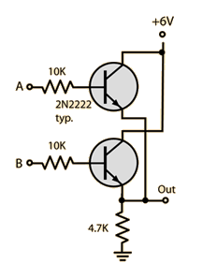
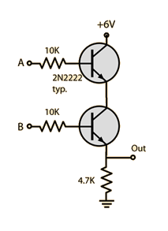
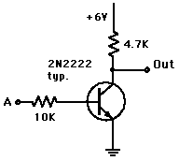
Activity: Designing BJT Logic Gates
OR AND
NOT

Slide 24
3 Basic Boolean Logic Operations
From these, we can perform any computation.
But before we discuss that, there are also a few more important logic gates that can be constructed from these 3 basic logic gates.

Slide 25
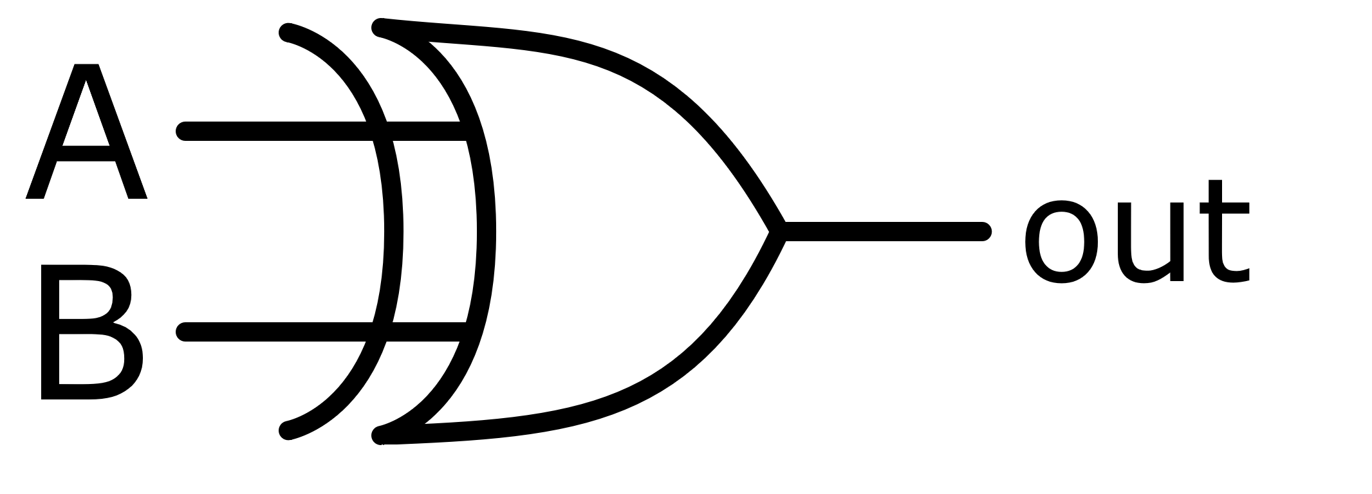
XOR

Slide 26
What is an exclusive or (XOR) gate?

Slide 27
XOR
Exp: You can go to Au Bon Pain or Sazon for breakfast. You can’t go to both.
You can do one, the other, but you can’t do both.
Considered Exclusive OR.
For the XOR operation to be true, we need 1 and only 1 to be true.
Input A | Input B | Output
0 | 0
0 | 1
1 | 0
1 | 1

Slide 28
XOR
Exp: You can go to Au Bon Pain or Sazon for breakfast. You can’t go to both.
You can do one, the other, but you can’t do both.
Considered Exclusive OR.
For the XOR operation to be true, we need 1 and only 1 to be true.
Input A | Input B | Output
0 | 0 | 0
0 | 1 | 1
1 | 0 | 1
1 | 1 | 0

Slide 29
Activity: Design an XOR Gate
How would you build an XOR gate?
Use only the 3 basic Boolean logic gates
AND
OR
NOT
Try starting with the truth table.

Slide 30
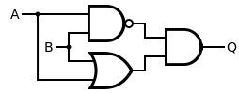
XOR Gate Construction
Many ways to construct it, but here is one way.

Slide 31
INVERTED GATES

Slide 32
Inverted Gates
There also exists inverted or negated logic gates.
They are:
NAND – negated and
NOR – negated inclusive or
XNOR – negated exclusive or
Can you draw the truth tables for these?

Slide 33
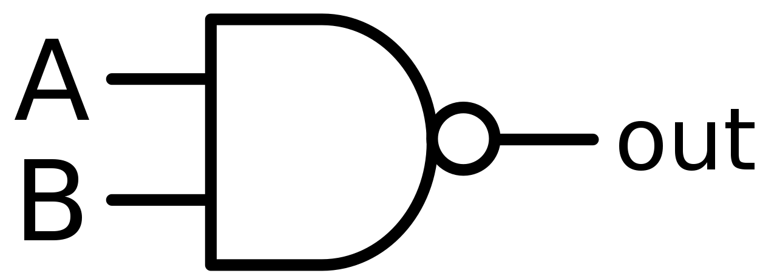
NAND
Negated AND gate.
For the NAND operation to be true, we need 1 input to be false.
Input A | Input B | Output
0 | 0
0 | 1
1 | 0
1 | 1

Slide 34
NAND
Negated AND gate.
For the NAND operation to be true, we need 1 input to be false.
Input A | Input B | Output
0 | 0 | 1
0 | 1 | 1
1 | 0 | 1
1 | 1 | 0

Slide 35
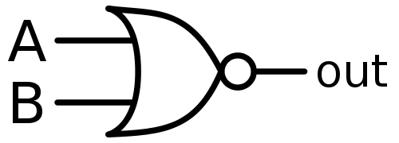
NOR
Negated OR gate.
For the NAND operation to be true, we need both inputs to be false.
Input A | Input B | Output
0 | 0
0 | 1
1 | 0
1 | 1

Slide 36
NOR
Negated OR gate.
For the NAND operation to be true, we need both inputs to be false.
Input A | Input B | Output
0 | 0 | 1
0 | 1 | 0
1 | 0 | 0
1 | 1 | 0

Slide 37
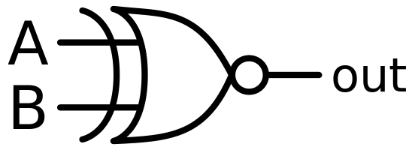
XNOR
Negated XOR gate.
For the XNOR operation to be true, we need both inputs to be false OR both inputs to be true.
Input A | Input B | Output
0 | 0
0 | 1
1 | 0
1 | 1

Slide 38
XNOR
Negated XOR gate.
For the XNOR operation to be true, we need both inputs to be false OR both inputs to be true.
Input A | Input B | Output
0 | 0 | 1
0 | 1 | 0
1 | 0 | 0
1 | 1 | 1

Slide 39
NOW WHAT?
How do we get from logic gates to software?
How do we construct something useful?
How is a computer built out of 3 logic operations?
Software
Programmable Logic
Hardware

Slide 40
BOOLEAN ALGEBRA

Slide 41

Conventions
NOT: $\overline{A}$is A inverted
Exp. $\overline{A}∙B$
OR: +
Exp. $A+B$
AND: $∙$
Exp. $A∙B$

Slide 42

Boolean Algebra Laws
Annulment Law – a term AND’ed with a “0” equals 0 or OR’ed with a “1” will equal 1.
$A∙0=0$
$A+1=1$
Identity Law – a term OR’ed with a “0” or AND’ed with a “1” will always equal that term.
$A+0=A$
$A∙1=A$
Idempotent Law – An input that is AND’ed or OR’ed with itself is equal to that input.
$A+A=A$
$A∙A=A$

Slide 43

Boolean Algebra Laws (contd.)
Complement Law – A term AND´ed with its complement equals “0” and a term OR´ed with its complement equals “1”.
$A∙\overline{A}=0$
$A+\overline{A}=1$
Commutative Law – The order of application of two separate terms is not important.
$A∙B=B∙A$
$A+B=B+A$
Double Negation Law – A term that is inverted twice is equal to the original term.
$\overset{̿}{A}=A$

Slide 44

Boolean Algebra Laws (contd.)
de Morgan’s Law
Two separate terms NOR’ed together is the same as the two terms inverted (Complement) and AND’ed.
Example: $\overline{A+B}=\overline{A}∙\overline{B}$
Two separate terms NAND’ed together is the same as the two terms inverted (Complement) and OR’ed.
Example: $\overline{A∙B}=\overline{A}+\overline{B}$

Slide 45
Boolean Algebra Laws (contd.)
Distributive Law – This law permits the multiplying or factoring out of an expression.
A.(B + C) = A.B + A.C (OR Distributive Law)
A + (B.C) = (A + B).(A + C) (AND Distributive Law)
Absorptive Law – This law enables a simplification of an expression by absorbing like terms.
A + (A.B) = A (OR Absorption Law)
A(A + B) = A (AND Absorption Law)
Associative Law – This law allows the removal of brackets from an expression and regrouping of the variables.
A + (B + C) = (A + B) + C = A + B + C (OR Associate Law)
A(B.C) = (A.B)C = A . B . C (AND Associate Law)

Slide 46
TRUTH TABLES TO BOOLEAN EXPRESSIONS

Slide 47

Truth Tables to Boolean Expressions
Construct expressions line by line when the output is true.
Example: if the input 111 resulted in a true output, the expression for that line would be $A∙B∙C = 1$.
What is the resulting Boolean
expression for the 2 truths and
a lie truth table on the right?
Input A | Input B | Input C | Output
0 | 0 | 0 | 0
0 | 0 | 1 | 0
0 | 1 | 0 | 0
0 | 1 | 1 | 1
1 | 0 | 0 | 0
1 | 0 | 1 | 1
1 | 1 | 0 | 1
1 | 1 | 1 | 0

Slide 48

Example: 2 Truths and a Lie
$Output=\overline{A}BC+A\overline{B}C+AB\overline{C}$
How would we simplify this?
Input A | Input B | Input C | Output
0 | 0 | 0 | 0
0 | 0 | 1 | 0
0 | 1 | 0 | 0
0 | 1 | 1 | 1
1 | 0 | 0 | 0
1 | 0 | 1 | 1
1 | 1 | 0 | 1
1 | 1 | 1 | 0

Slide 49
Example: 2 Truths and a Lie
We can’t!
Many times you will try to apply the Boolean algebra laws in circles until you find it’s not able to be simplified.

Slide 50
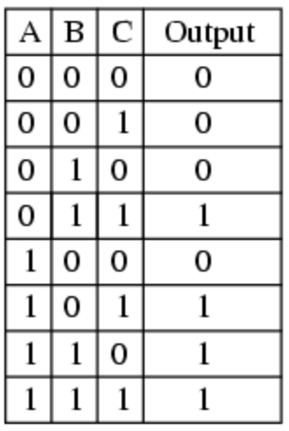
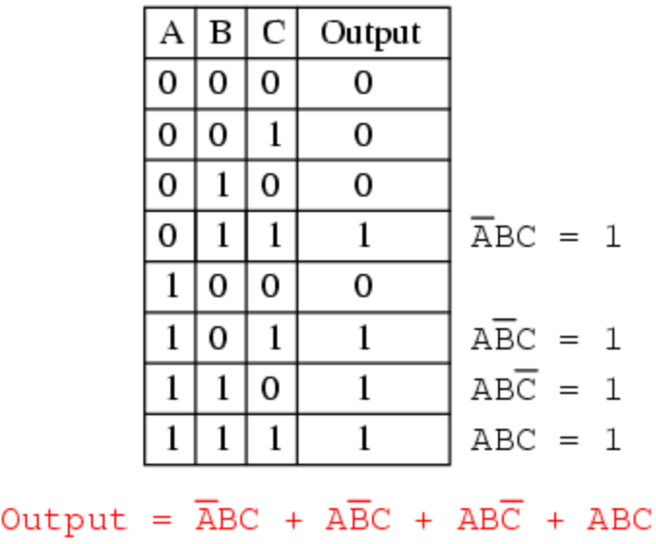
Example: Boolean Algebra
How would you simplify this?

Slide 51
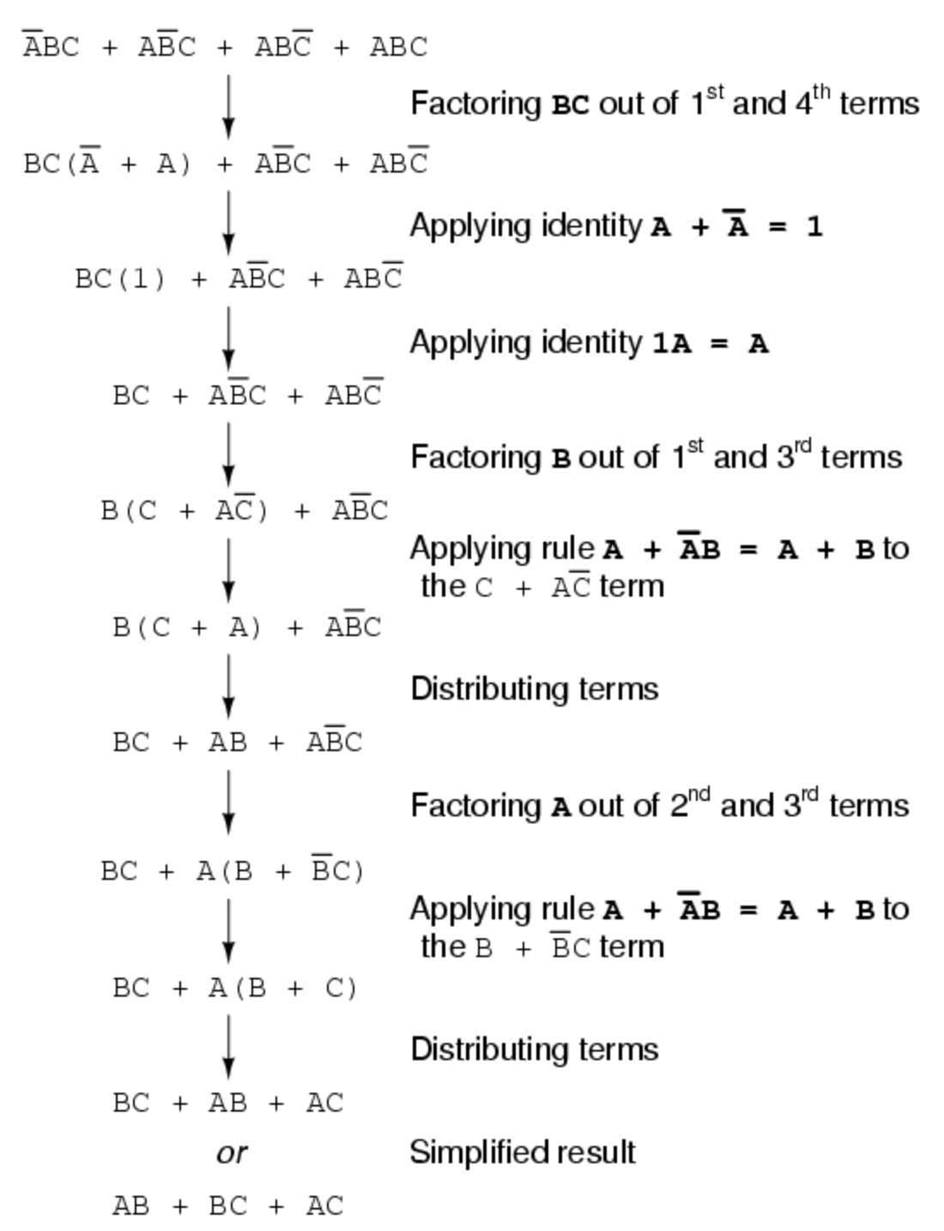
Example Solution

Slide 52
ACTIVITIES

Slide 53
Logic Gates
SN74LS32N – OR Gate – 2 inputs – 4 channels
SN74LS08N – AND Gate – 2 inputs – 4 channels
SN74LS04N – NOT Gate – 1 input – 6 channels
SN74LS03N – NAND Gate – 2 inputs – 4 channels

Slide 54
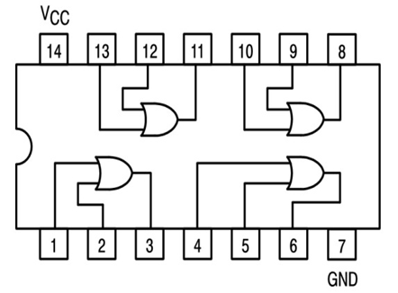
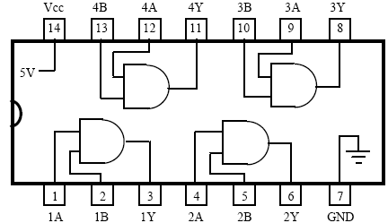
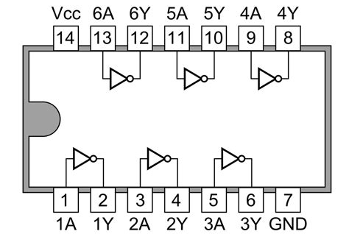
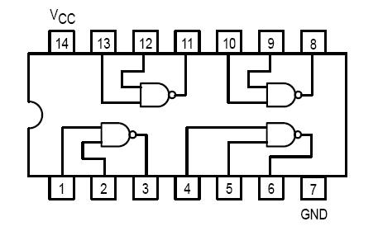
Logic Gate Pinouts

Slide 55
How should we set up the inputs?
How do we wire the switch?
Can’t leave it floating. Need to provide discrete inputs: logic low and logic high.
Should limit voltage to protect LEDs.

Slide 56
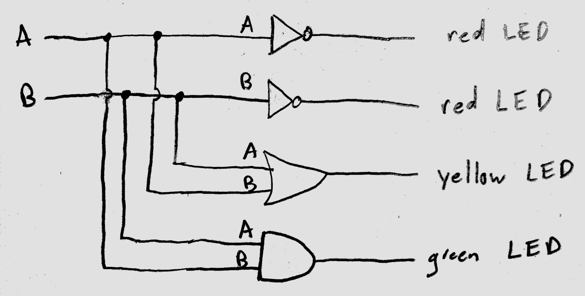
Activity: Building 3 Basic Logic Ops
Construct a circuit that has 2 inputs and an output from each gate.
It should turn on an LED when the output is high.

Slide 57
Activity: Adder
Construct an adder using AND, OR, NOT logic gates to add a 1-bit number to another 1-bit number.
Start by drawing the truth table!
Construct it to test.
Adding a 1-bit number to a 1-bit number results in a 2-bit output.
Drive 2 LEDs to show the 2 output bits.

Slide 58
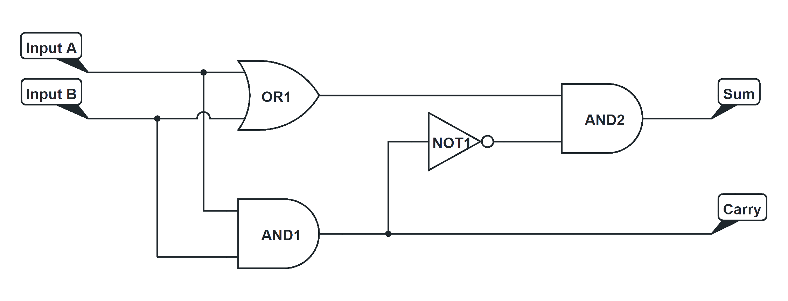
Activity: Adder
Input A | Input B | Carry | Sum
0 | 0 | 0 | 0
0 | 1 | 0 | 1
1 | 0 | 0 | 1
1 | 1 | 1 | 0
This is called a half adder!

Slide 59
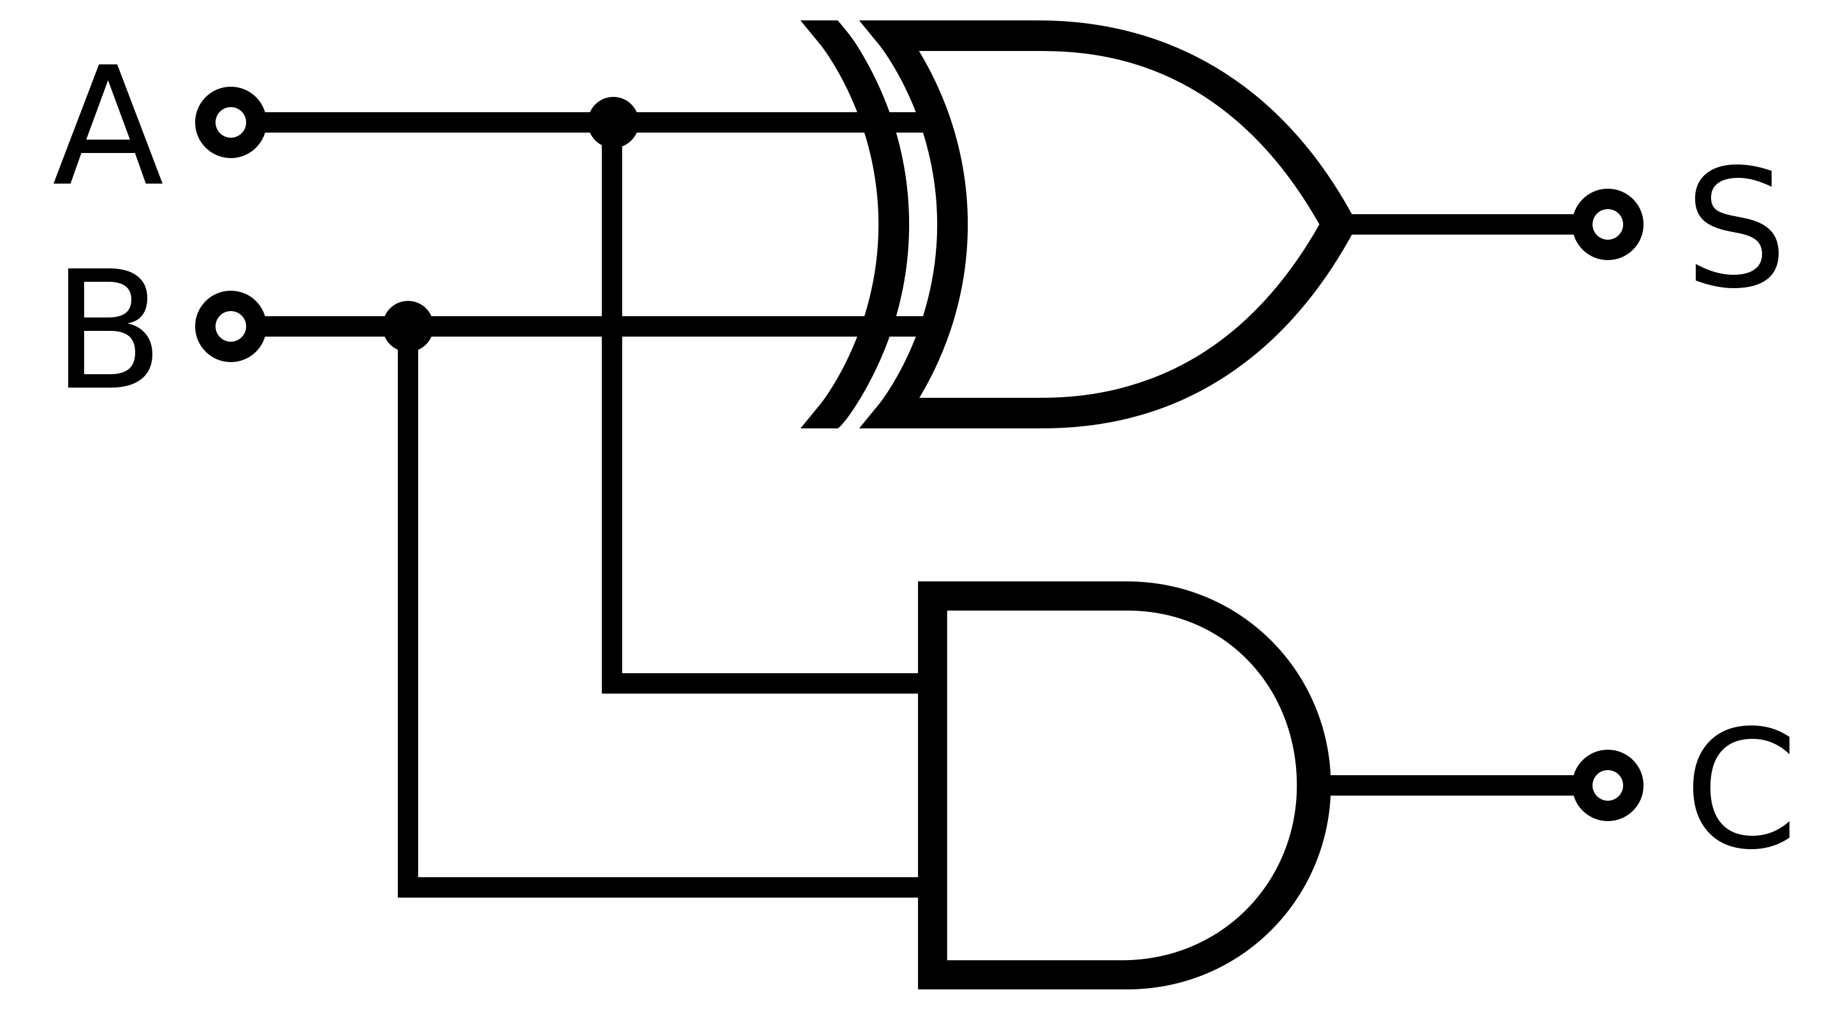
Half Adder
Input A | Input B | Carry | Sum
0 | 0 | 0 | 0
0 | 1 | 0 | 1
1 | 0 | 0 | 1
1 | 1 | 1 | 0
More easily constructed with an XOR gate.

Slide 60
Activity: Full Adder
If that’s a half-adder, presumably there’s a full adder.
What would it look like?
What would it allow us to do?
Hint: how could we chain adders together to be able to add more bits at a time?

Slide 61
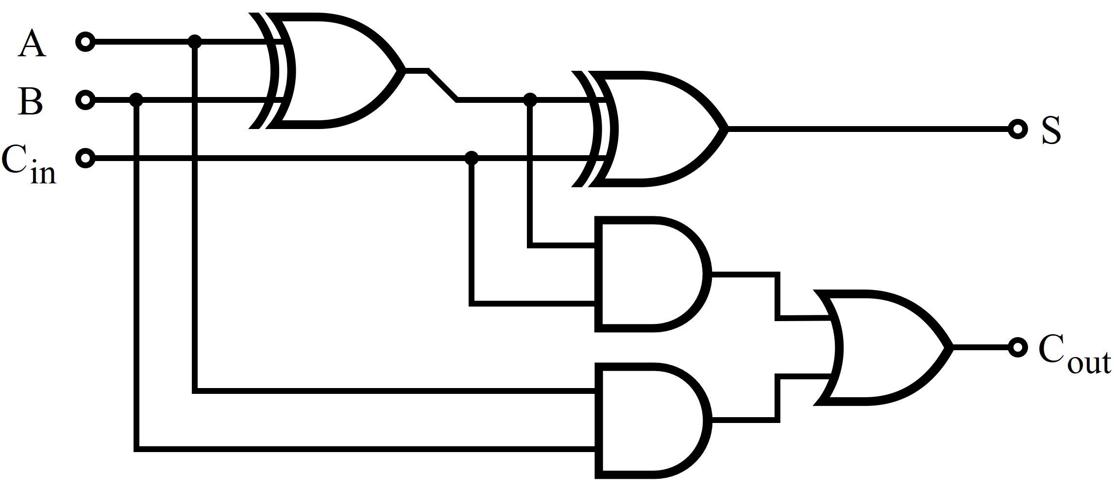
Activity: Full Adder

Slide 62
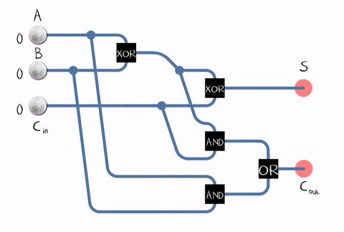
Full Adder

Slide 63
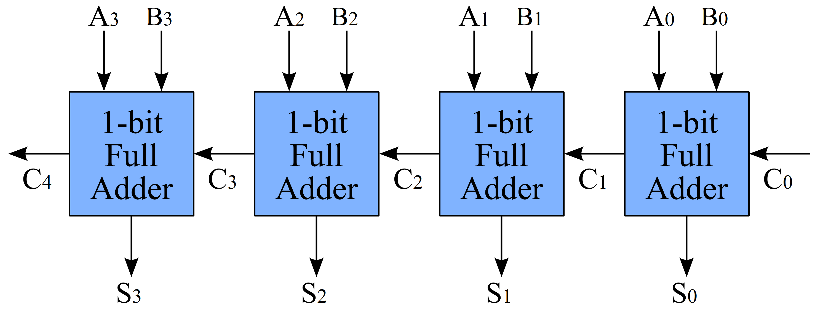
4-bit Adder

Slide 64
COMBINATIONAL AND SEQUENTIAL LOGIC

Slide 65
Types of Circuit Logic
You just constructed your first pieces of logic.
These pieces can be used to construct an Arithmetic Logic Unit (ALU).
The logic you just constructed is considered combinational.
There are two types of logic we will use to construct the basis for computing.

Slide 66
Building Functions from Logic Gates
From the Boolean logic gates/operations we discussed, we can construct two different types of logic.
Combinational Logic Circuit
output depends only on the current inputs
stateless
Sequential Logic Circuit
output depends on the sequence of inputs (past and present)
stores information (state) from past inputs

Slide 67
Combinational vs. Sequential
Combinational Circuit - output depends only on inputs
Always gives the same output for a given set of inputs
Example: adder always generates sum and carry, regardless of previous inputs
Sequential Circuit - output depends on stored information (state) plus inputs
Stores information - so a given input might produce different outputs, depending on the stored information
Example: “volume up” button. Increases the volume, but does so in relation to the present volume level.
Useful for building memory elements and state machines.

Slide 68
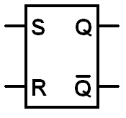
S-R Latch: Simple Storage Element
R is used to “reset” the element – set it to 0.
S is used to “set” the element – set it to 1.
If both R and S are 1, Q could be either 0 or 1.
“quiescent” state - holds its previous value

Slide 69
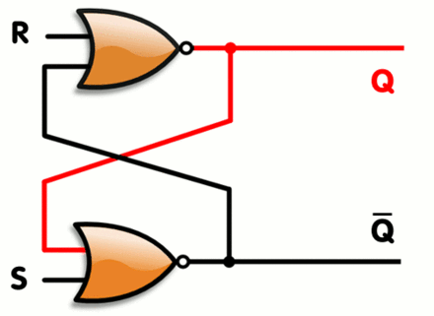
SR Latch or Flip Flop
A latch circuit that has two stable states and can be used to store information.
S – Set, drives output Q high
R – Reset, drives output Q low
Q’ – an inversion of output Q
S | R | Q
0 | 0 | hold
0 | 1 | 0 (reset)
1 | 0 | 1 (set)
1 | 1 | Forbidden

Slide 70
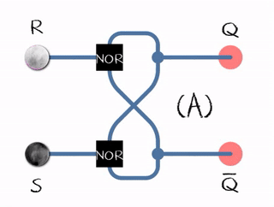
SR Latch
An animated SR latch. Black and white mean logical '1' and '0', respectively. (A) S = 1, R = 0: set (B) S = 0, R = 0: hold (C) S = 0, R = 1: reset (D) S = 1, R = 1: not allowed Transitioning from the (D) to (A) leads to an unstable state.

Slide 71
Activity: Memory
How could we implement the same logic using 2 NAND gates and inverters?
Drive an LED with you output to show that it holds state like a memory element.

Slide 72
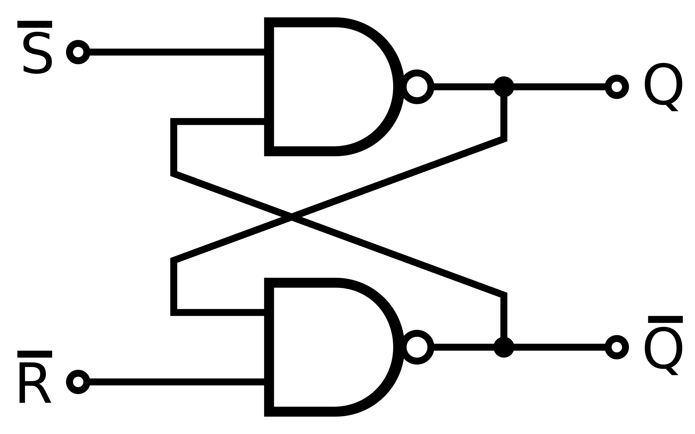

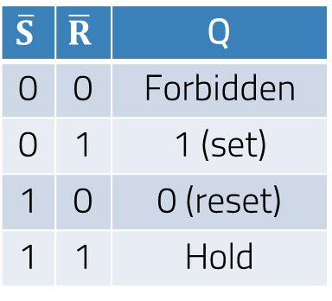
$\overline{SR}$ NAND Latch
$$\overline{S}$$ | $$\overline{R}$$ | Q
0 | 0 | Forbidden
0 | 1 | 1 (set)
1 | 0 | 0 (reset)
1 | 1 | Hold

Slide 73
SOFTWARE LEVEL

Slide 74
LEVELS OF ABSTRACTION
Software
Programmable Logic
Hardware
Fundamental Theorem of Software Engineering:
"We can solve any problem by introducing an extra level of indirection.“ – Andrew Koenig

Slide 75
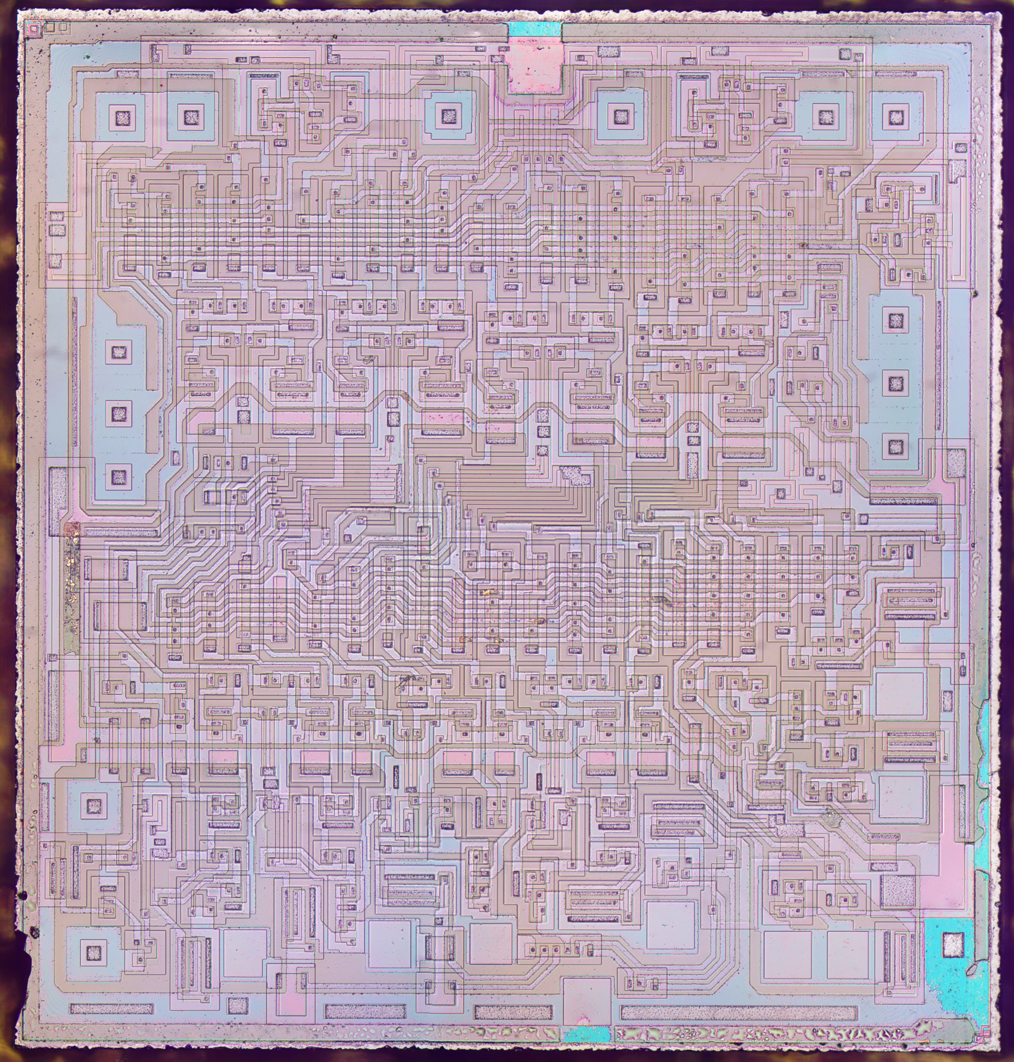
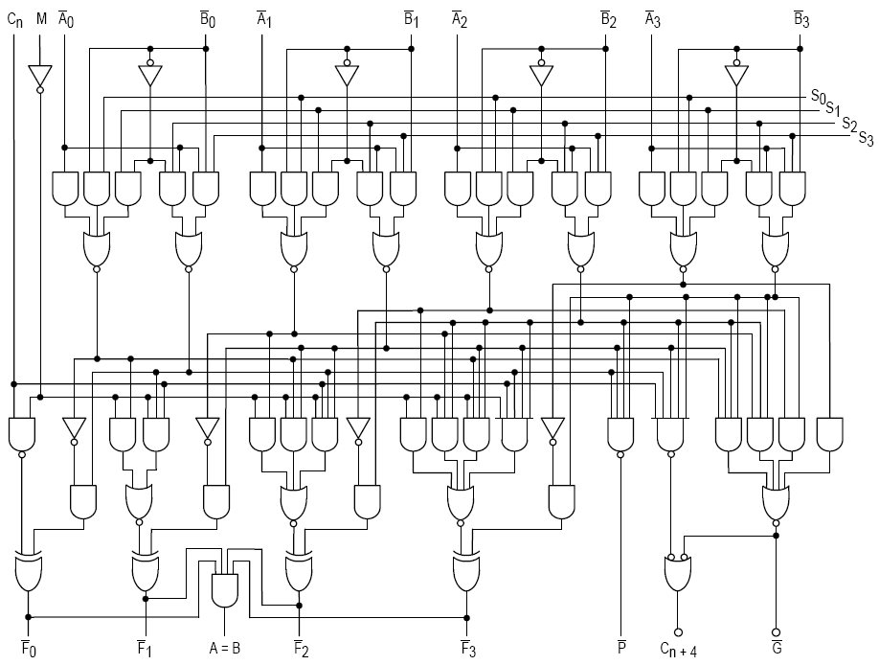
ARITHMETIC LOGIC UNIT (ALU) - 74181
Hardware abstraction level
Programmable logic abstraction level
Software abstraction level
8 + 7 = ?
Or calculating pixel
color and location
75

Slide 76
MORE ACTIVITIES

Slide 77
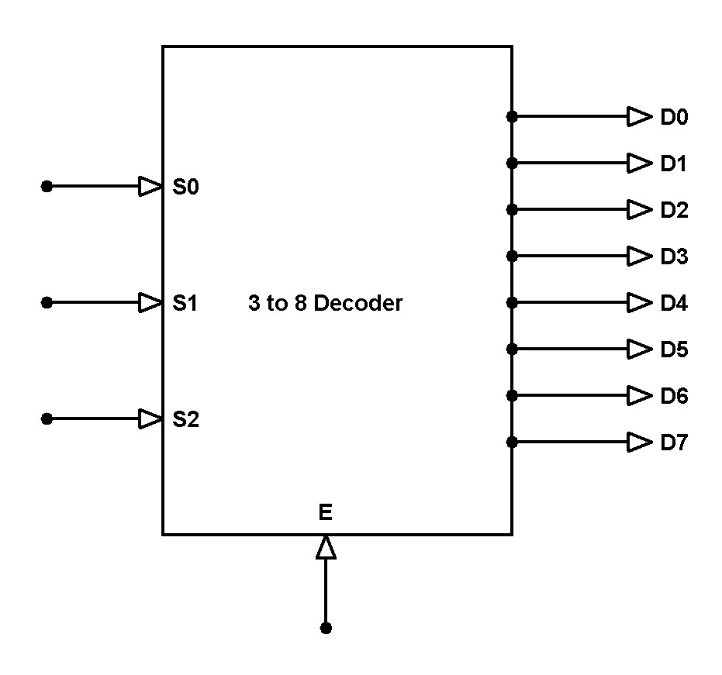
Activity: 3-Bit Binary Decoder
3 lines to 8 lines
Could we use it to drive a 7-segment LED?

Slide 78
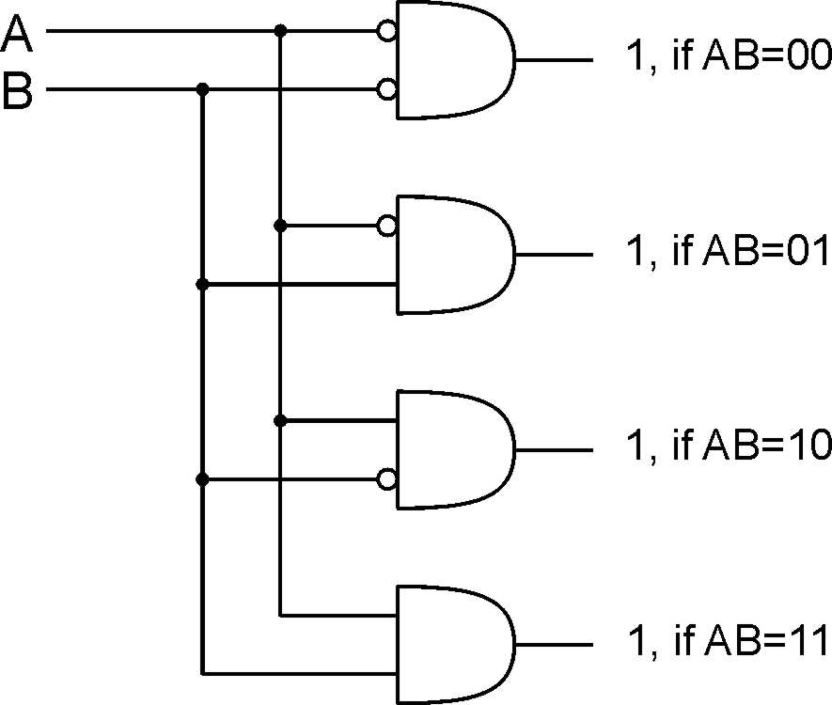
2-bit Decoder

Slide 79
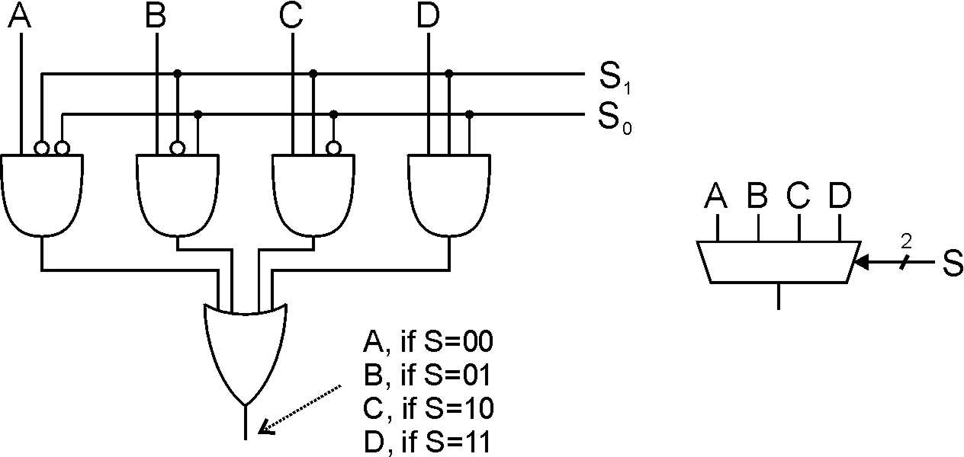
Activity: Multiplexer (MUX)
n-bit selector and 2^{n} inputs, one output
Output equals one of the inputs, depending on selector bits.
Design a 4-to-1 Multiplexer
4-to-1 MUX
Notes:
Another view: decode S, and AND each output with one of the MUX inputs.
Also explain multi-bit inputs.
Uses of multiplexer:
select which input to use for function
select which computed value to pass to next stage (or to place on bus)

Slide 80
Multiplexer (MUX)
4-to-1 MUX
Notes:
Another view: decode S, and AND each output with one of the MUX inputs.
Also explain multi-bit inputs.
Uses of multiplexer:
select which input to use for function
select which computed value to pass to next stage (or to place on bus)

Slide 81
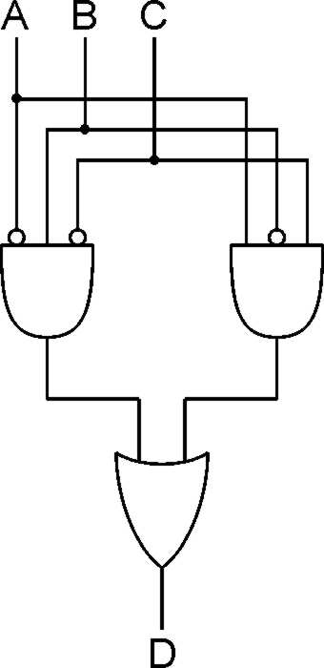
Logical Completeness
Can implement ANY truth table with AND, OR, NOT.
A | B | C | D
0 | 0 | 0 | 0
0 | 0 | 1 | 0
0 | 1 | 0 | 1
0 | 1 | 1 | 0
1 | 0 | 0 | 0
1 | 0 | 1 | 1
1 | 1 | 0 | 0
1 | 1 | 1 | 0
1. AND combinations that yield a "1" in the truth table.
2. OR the results of the AND gates.
Notes:
Note the use of the bubbles (NOT) in the input.

Slide 82
ADDITIONAL INFO

Slide 83
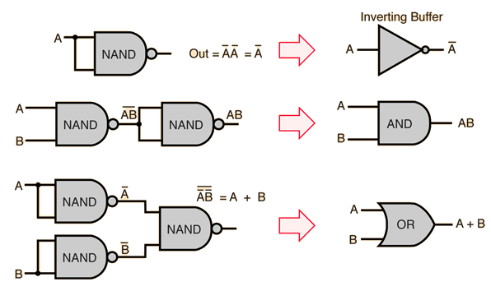
NAND Gates
You can construct any logic possible using just NAND gates!

Slide 84
NAND Gate Equivalents

Slide 85
Activity: NAND Gate Adder
How would you design a 2-bit adder using just NAND gates?

Slide 86
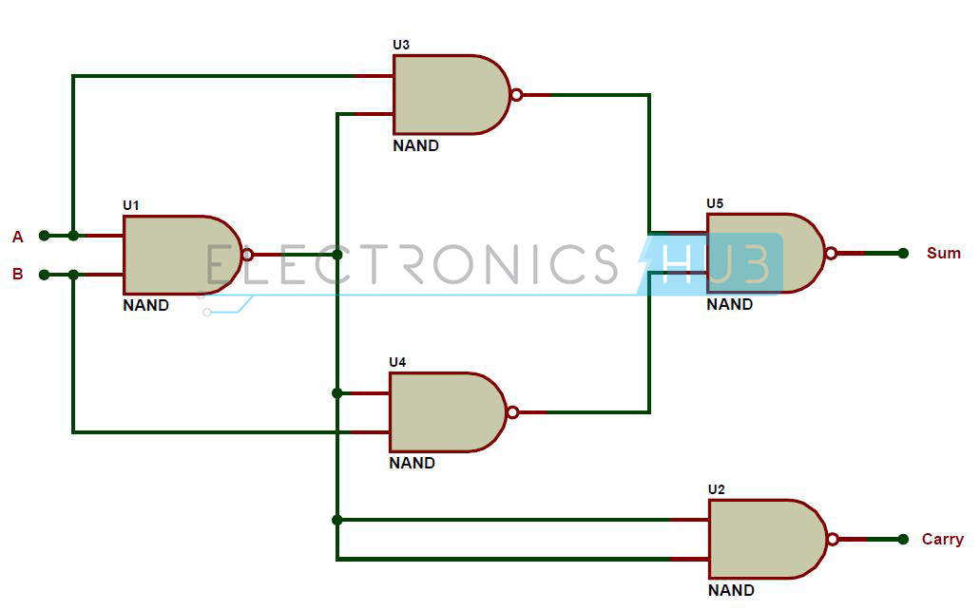
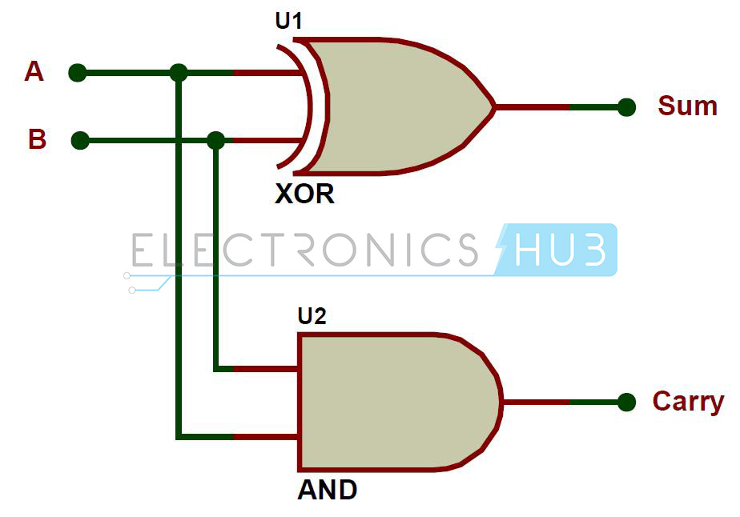
NAND Gates Adder Construction

